Slide 1
TypeScript
Binary Studio Academy

Slide 2
What is TypeScript?
TypeScript is an open-source typed language which builds on JavaScript.
TypeScript code is transformed into JavaScript code via the TypeScript compiler.
All valid JavaScript code is also TypeScript code.
// TypeScript
function sum(values: number[]): number {
let result: number = 0;
for (const value of values) {
result = result + value;
}
return result;
}
sum([1, 2, 3]);
// JavaScript
function sum(values) {
let result = 0;
for (const value of values) {
result = result + value;
}
return result;
}
sum([1, 2, 3]);

Slide 3
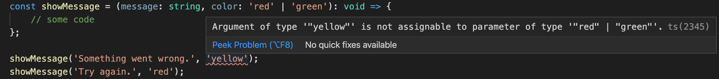
Type Annotations
Typescript uses type annotation to specify the data type of the variable, function or function return value. It uses the syntax :[type], where type is the Typescript type. Once you have annotated an identifier to be of a certain type, you can only use it as that type. The Typescript compiler throws an error if you use the identifier as a different type.

Slide 4
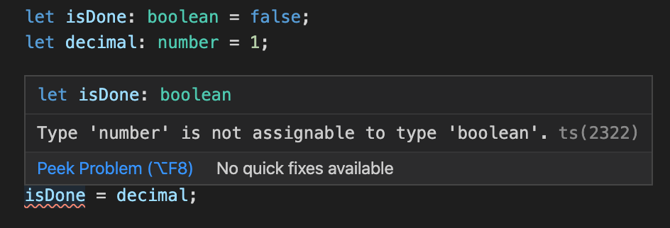
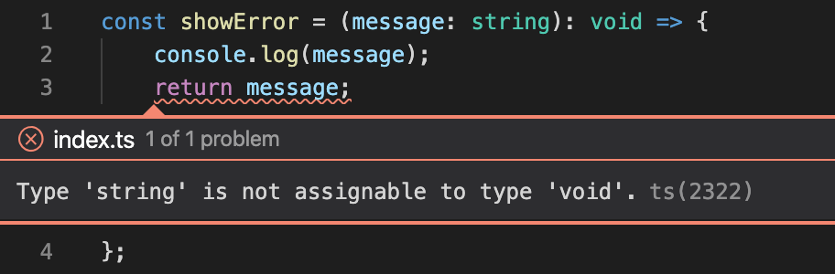
Basic Types
Boolean
Number
String
Array
Tuple
Enum
Any
Void
Null and Undefined
Never
Objects

Slide 5
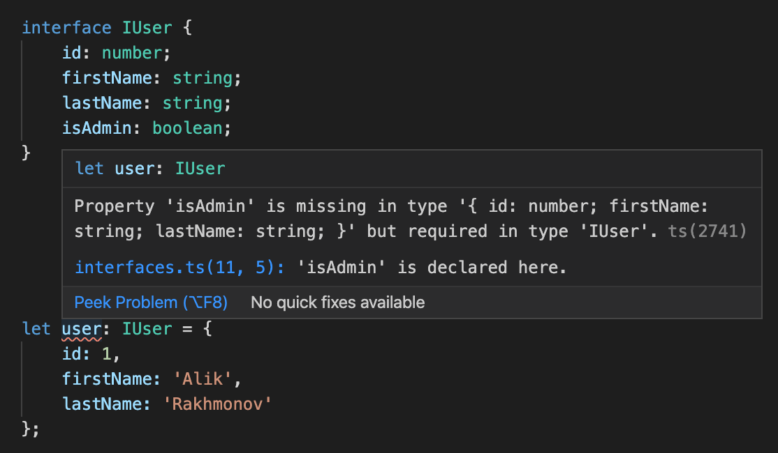
Interface
One of TypeScript’s core principles is that type checking focuses on the shape that values have. This is sometimes called “duck typing” or “structural subtyping”. In TypeScript, interfaces fill the role of naming these types, and are a powerful way of defining contracts within your code as well as contracts with code outside of your project.

Slide 6
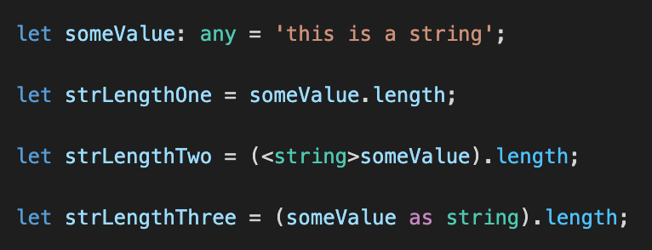
Type Assertions
Type assertion allows you to set the type of a value and tell the compiler not to infer it. This is when you, as a programmer, might have a better understanding of the type of a variable than what TypeScript can infer on its own.

Slide 7
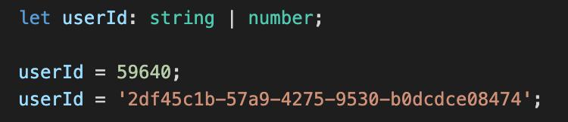
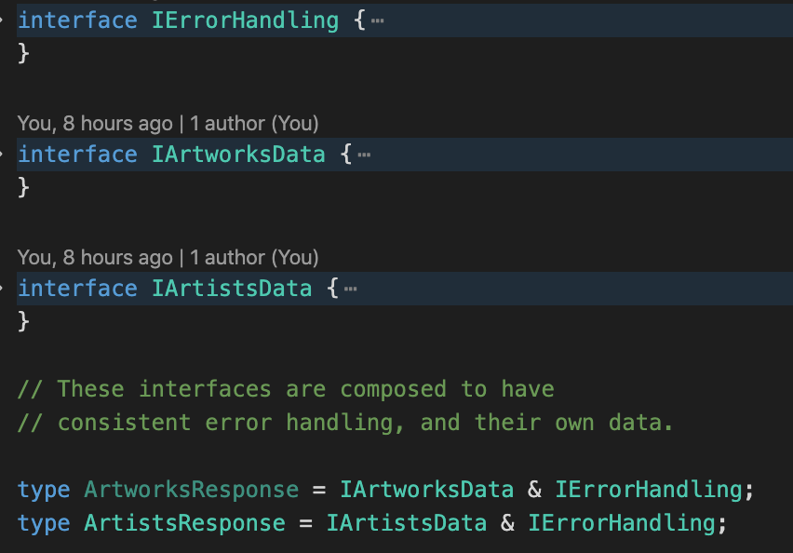
Unions and Intersection Types
TypeScript allows us to use more than one data type for a variable or a function parameter. This is called union type.
An intersection type combines multiple types into one. This allows you to add together existing types to get a single type that has all the features you need.

Slide 8
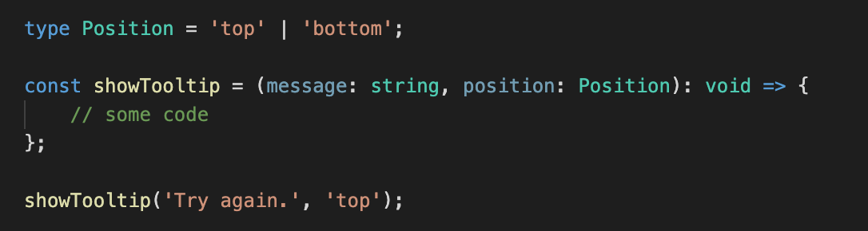
Type Aliases
Type aliases create a new name for a type. Type aliases are sometimes similar to interfaces, but can name primitives, unions, tuples, and any other types that you’d otherwise have to write by hand.

Slide 9
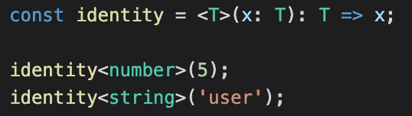
Generics
The implementation of generics in Typescript give us the ability to pass in a range of types to a component, adding an extra layer of abstraction and re-usability to your code. Generics can be applied to functions, interfaces and classes in Typescript.

Slide 10
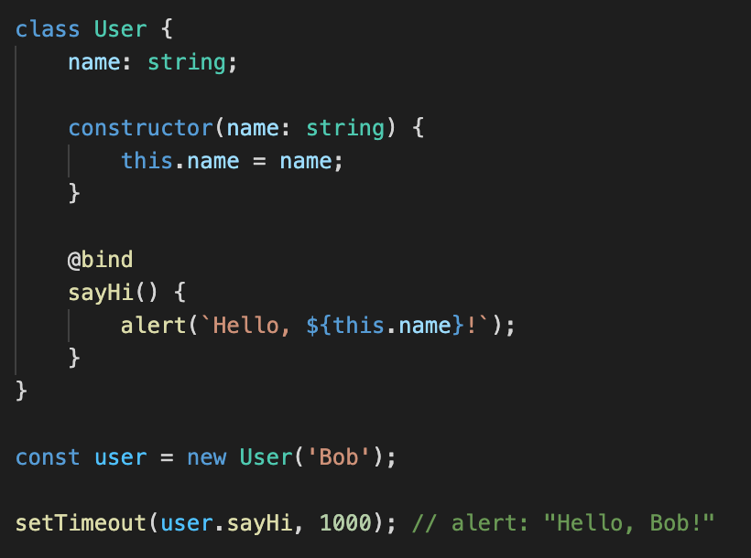
Decorators
A Decorator is a special kind of declaration that can be attached to a class declaration, method, accessor, property, or parameter. Decorators use the form @expression, where expression must evaluate to a function that will be called at runtime with information about the decorated declaration.

Slide 11
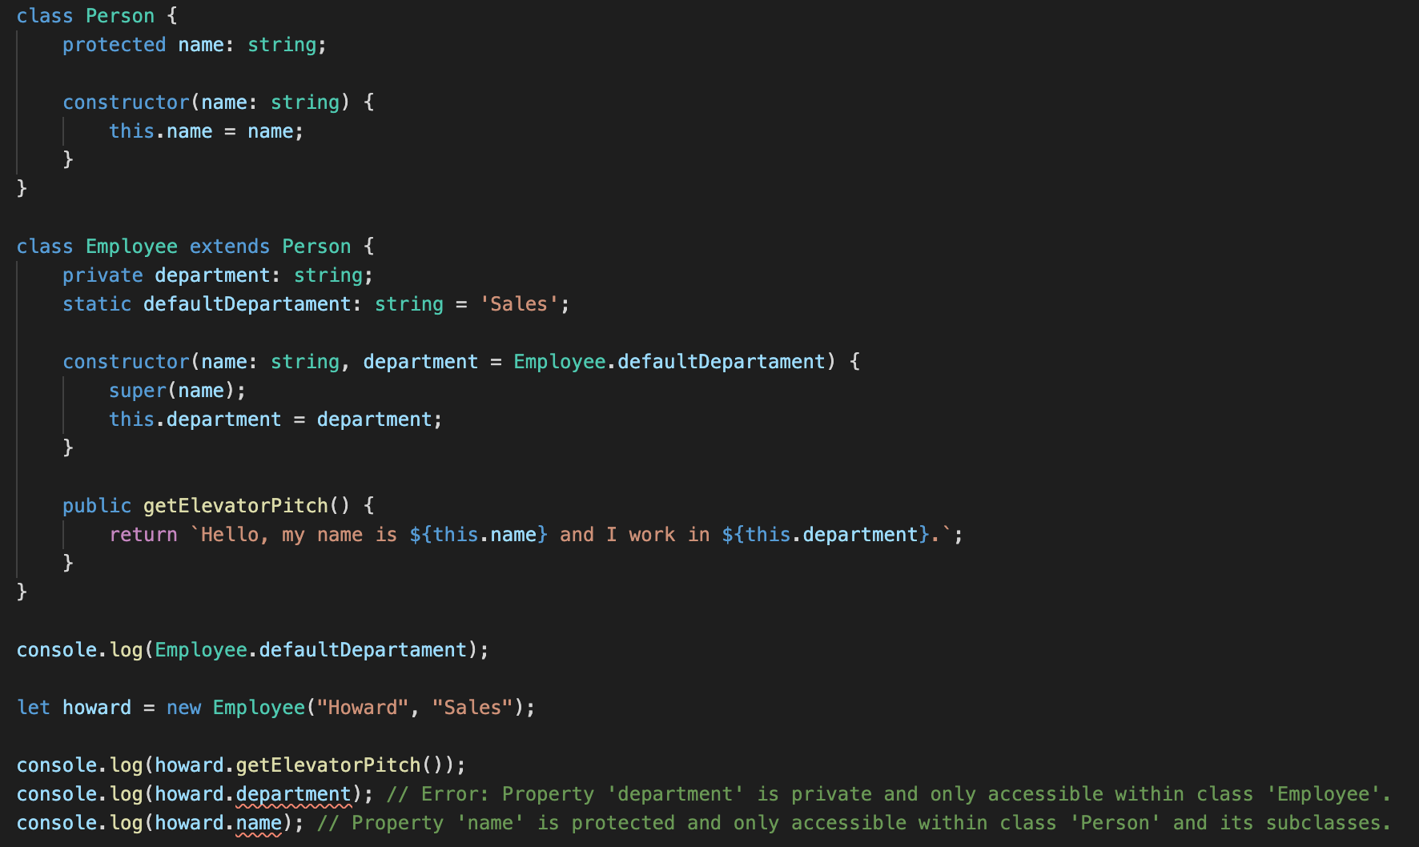
Classes

Slide 12
Install
Run
NPM (Node Package Manager) *
In your project
> npx tsc app.ts
Globally
> tsc app.ts
NPM (Node Package Manager) *
In your project
> npm install typescript --save-dev
Globally
> npm install -g typescript
* Or you can use yarn, pnpm or Nuget for MSBuild projects.

Slide 13
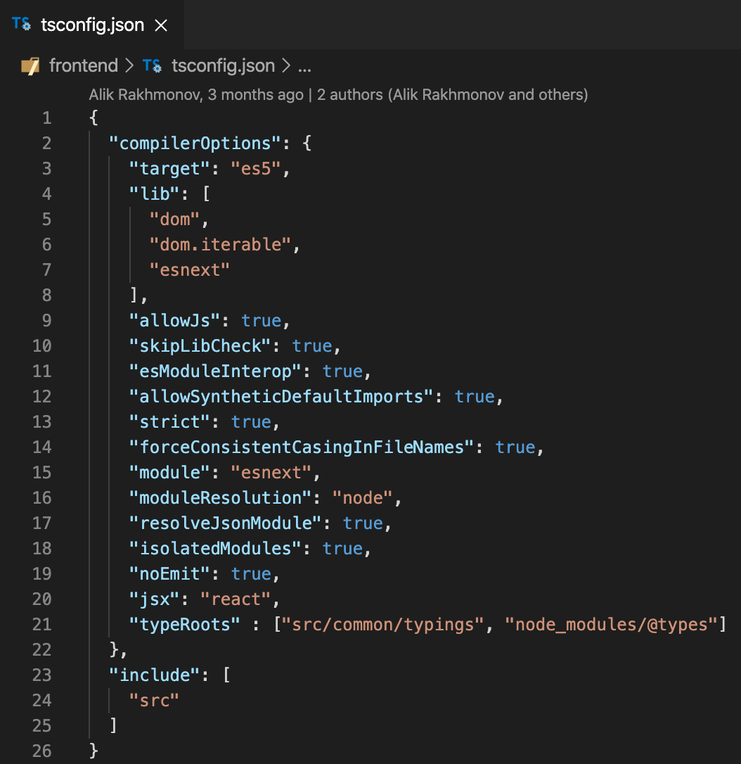
tsconfig.json
The presence of a tsconfig.json file in a directory indicates that the directory is the root of a TypeScript project. The tsconfig.json file specifies the root files and the compiler options required to compile the project.
When input files are specified on the command line, tsconfig.json files are ignored.

Slide 14
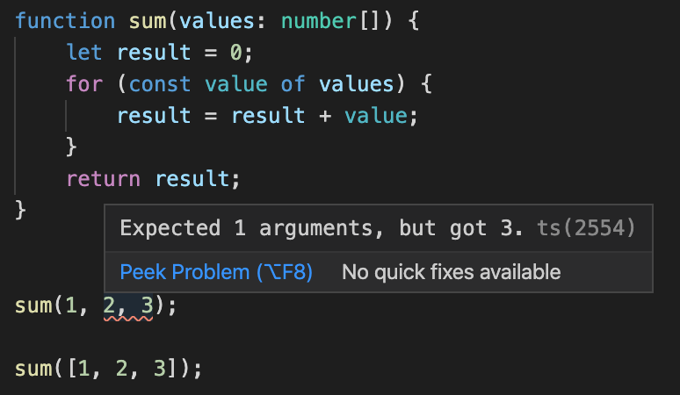
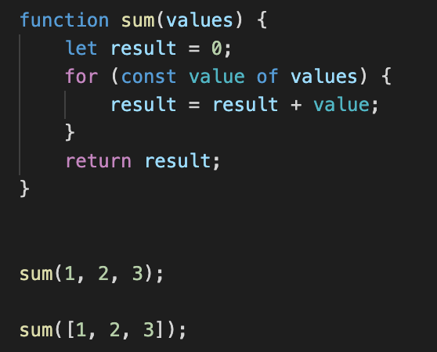
Benefits
TypeScript
Optional static typing
Type inference
Readability
Predictability
Maintainability
Scalability
IntelliSense
Future today
JavaScript

Slide 15
Thank you!

